Slide 1

LNHS PTSA
Tuesday, May 16, 2023
6:30pm
General Meeting
Review Bylaws & Budget
Board Member Recognition & Awards

Slide 2

LNHS PTSA Meeting Agenda
May 16, 2023
Agenda:
Welcome/Confirm Quorum
Meeting Called to Order by President
Introductions/Special Guests
Position Board Members
President Christal Feldman
1st VP - Membership Brenda Meadows
Treasurer Michelle Adamick
Recording Secretary Gabriella Nguyen
Corresponding Secretary Sophia Rogers
Chairs
LWL Advisors Suzanne Arnold/Tania Abreu
Finance Gita Raghoonandan
Staff Appreciation Angie Garcia/Hannah Howell
Legacy Bricks Dierdre Smith/Kristie Zappas
Web Master Erika Remley
Staff Liaison Kari Grimm
OLD BUSINESS
Approval of Past Minutes (April)
Review of April Financial Report
NEW BUSINESS
Our PTSA Does What?
Budget Review
Bylaws Review
Membership Updates
Spirit Wear Sales
Staff Appreciation
Outgoing Board Member Recognition
Presidential Service Awards
Incoming Board Members
Thank You Community Partners
Communication Updates/Announcements
Next General Meeting - August, Date TBD
Meeting Adjourned by President
Thank You Outgoing Board Members and Welcome Incoming Board Members!

Slide 3
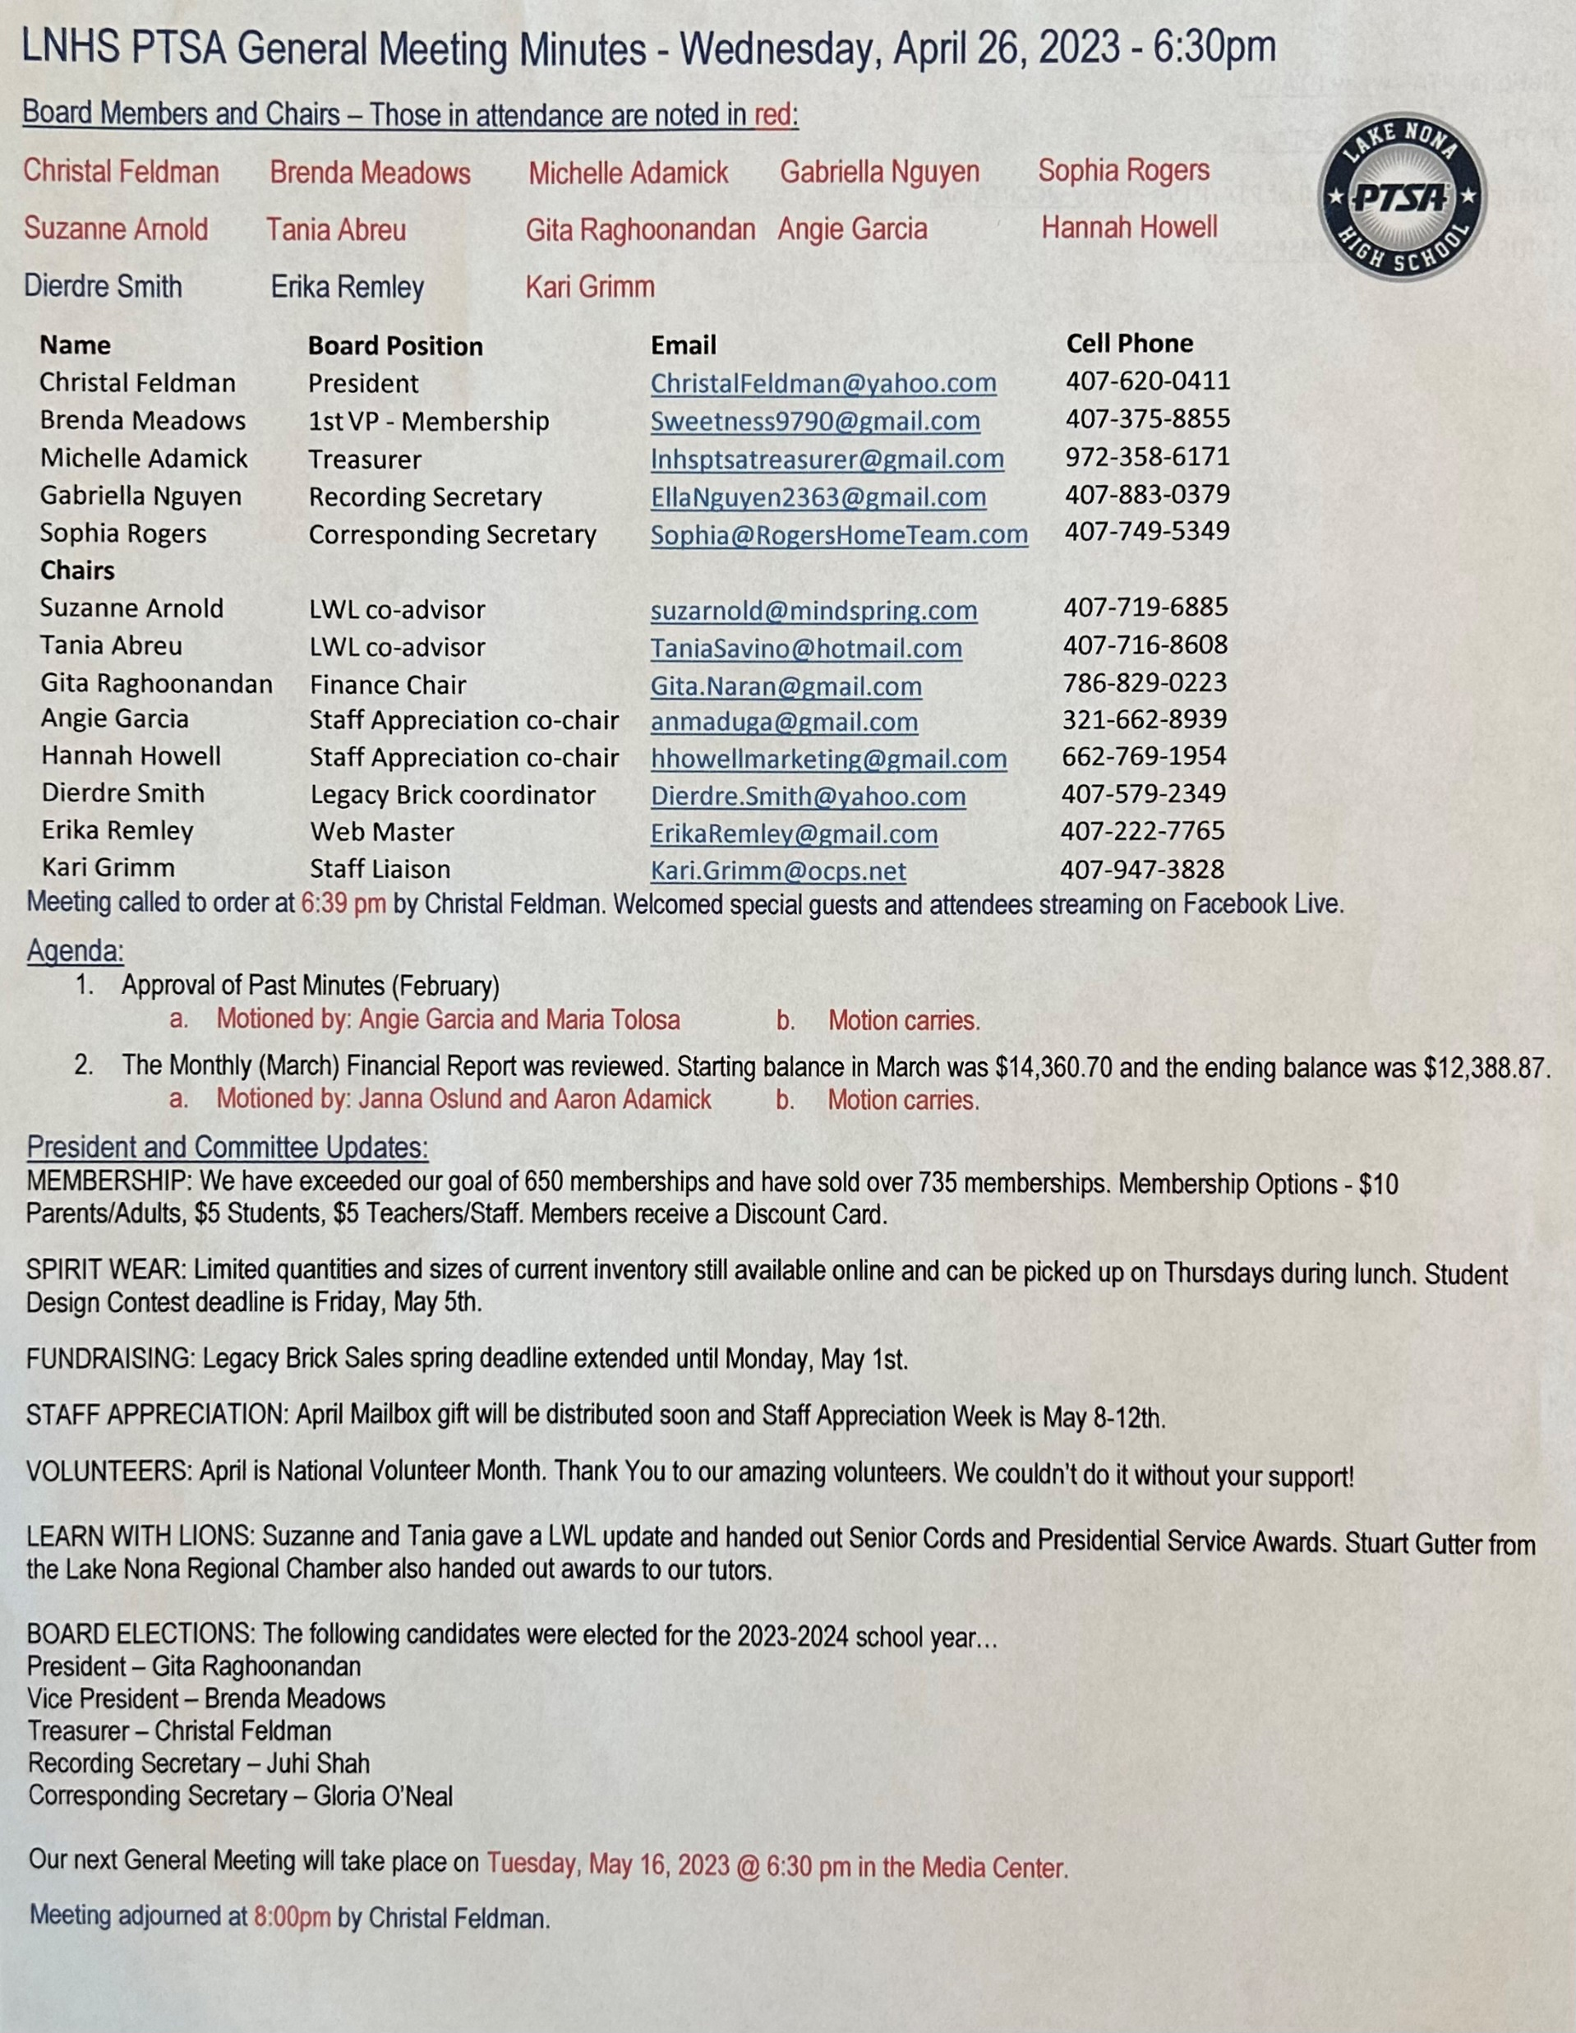

PAST
MINUTES
FOR APPROVAL
April 26, 2023

Slide 4
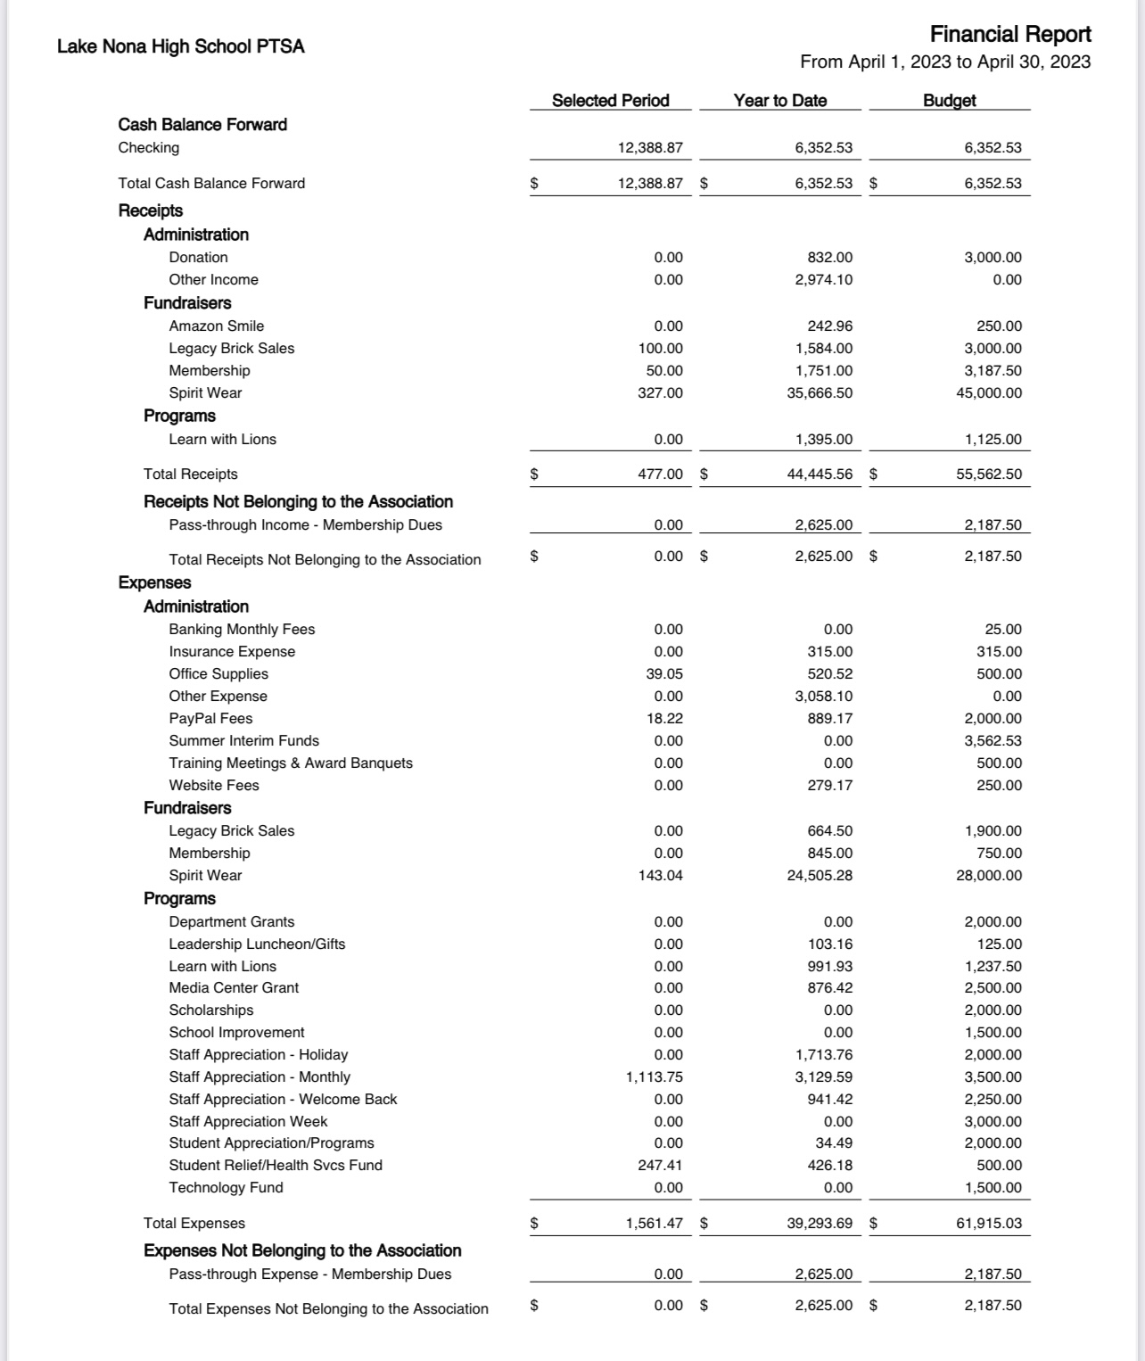
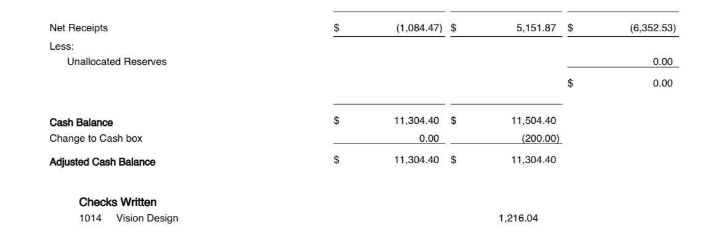
FINANCIAL REPORT
FOR APPROVAL
April 2023 Financial Report
Year to Date Summary
April Beginning Balance - $12,388.87
April Ending Balance - $11,304.40

Slide 5


AFFORDABLE SPIRIT WEAR
DEPARTMENT GRANTS
AP Human Geo, AP Lit, APUSH,
ELA, ESOL and Theatre
KINDNESS TREE
MEDIA CENTER GRANT
SENIOR SCHOLARSHIPS
STAFF APPRECIATION
STUDENT RELIEF FUND
Supplies for Clinic and Cub’s Cabinet
Kari’s Kloset
AND MORE…
- LEARN WITH LIONS TUTORING CLUB
- MONTHLY MEETING TOPICS/GUEST SPEAKERS
- MICROWAVE DONATED BY PARENT
- HURRICANE IAN RELIEF
OUR PTSA
DOES WHAT?
Connecting Families, Schools and Communities

Slide 6
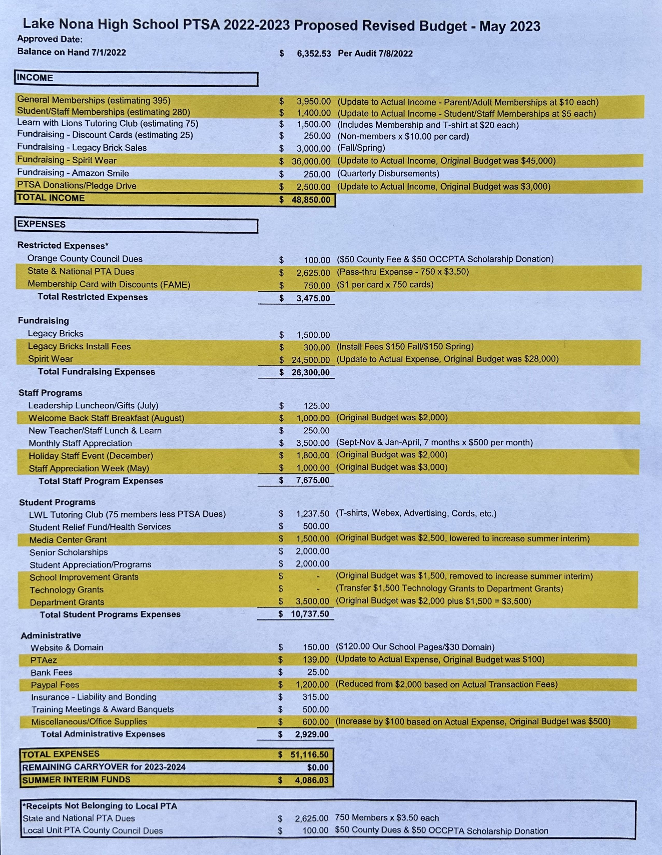
2022-2023
LNHS PTSA PROPOSED
REVISED BUDGET
FOR APPROVAL
Annual Budget
July 2022 - June 2023

Slide 7
2022-2023
LNHS PTSA
REVIEW OF BYLAWS

Slide 8


PTSA
MEMBERSHIP
We received 750 Memberships!
Our Goal was 650 Memberships
OVER 75 Teachers & Staff
OVER 280 Students
OVER 25 Community Members
OVER 30% INCREASE FROM LAST YEAR
Membership Options
Parent/Adult - $10
Teachers & Staff - $5
Students - $5
(Includes Discount Card)

Slide 9


SPIRIT WEAR
- Limited Quantities and Sizes Available
(Youth up to 3XL)
- Spirit Store On Campus
(Thursdays During Lunch)
- Online Sales will End on June 2nd

Slide 10
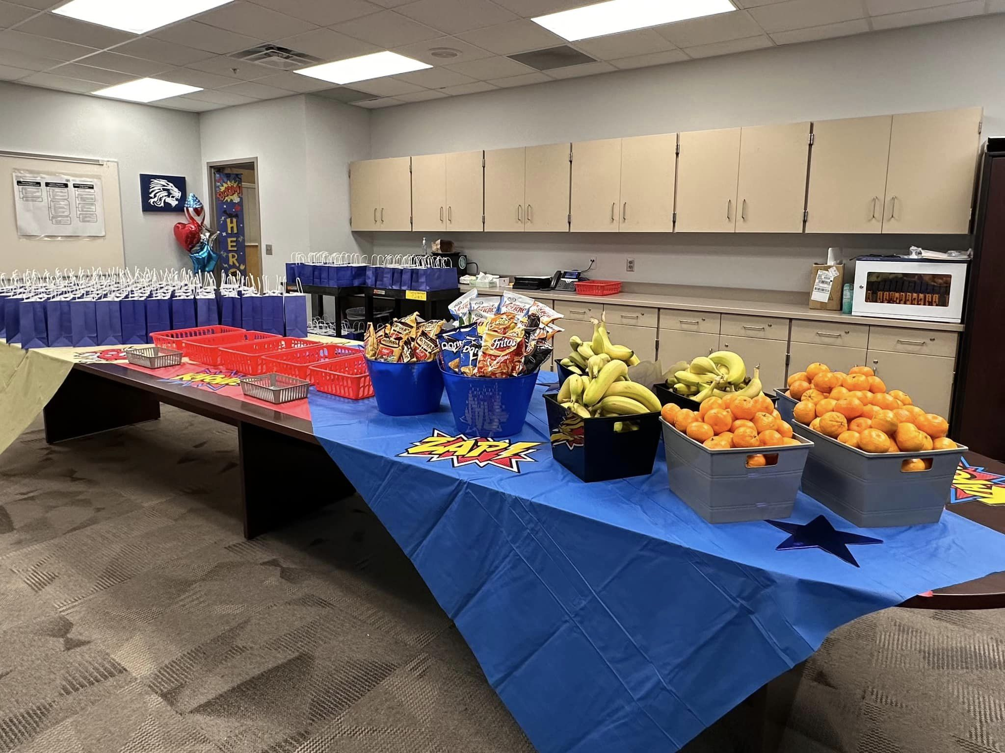

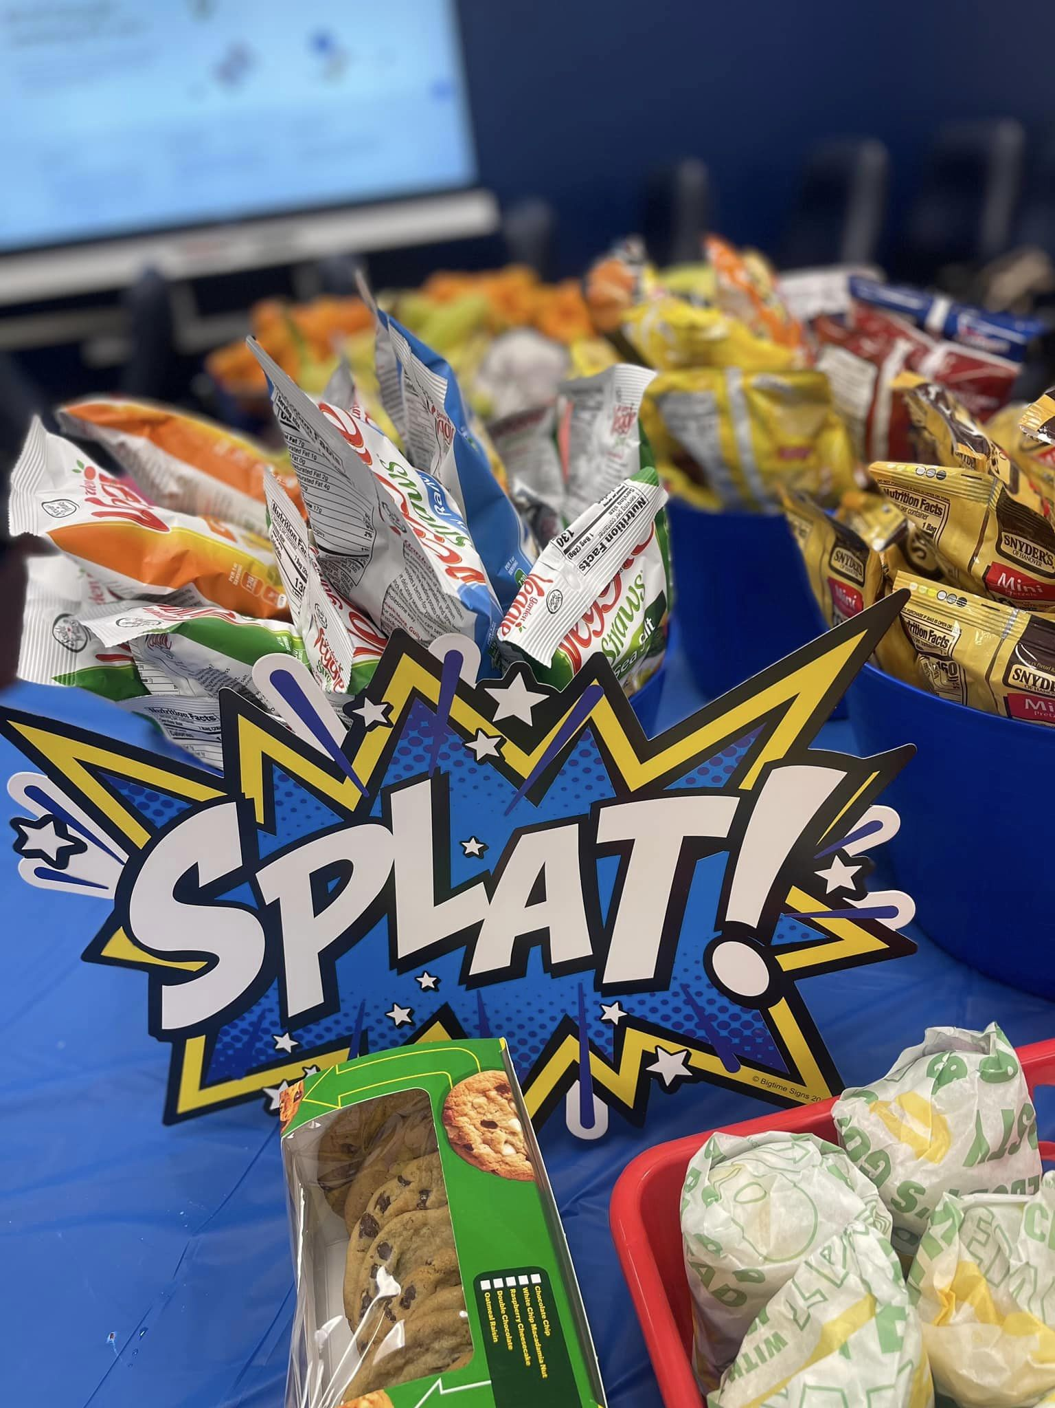
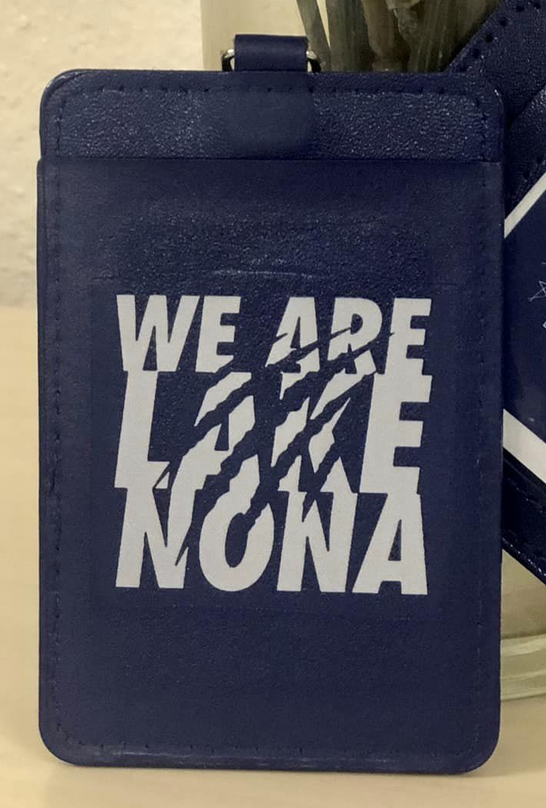




STAFF
APPRECIATION
APRIL
Mailbox Gift
May 8 - 12, 2023
Grab & Go Lunch
May 9th

Slide 11
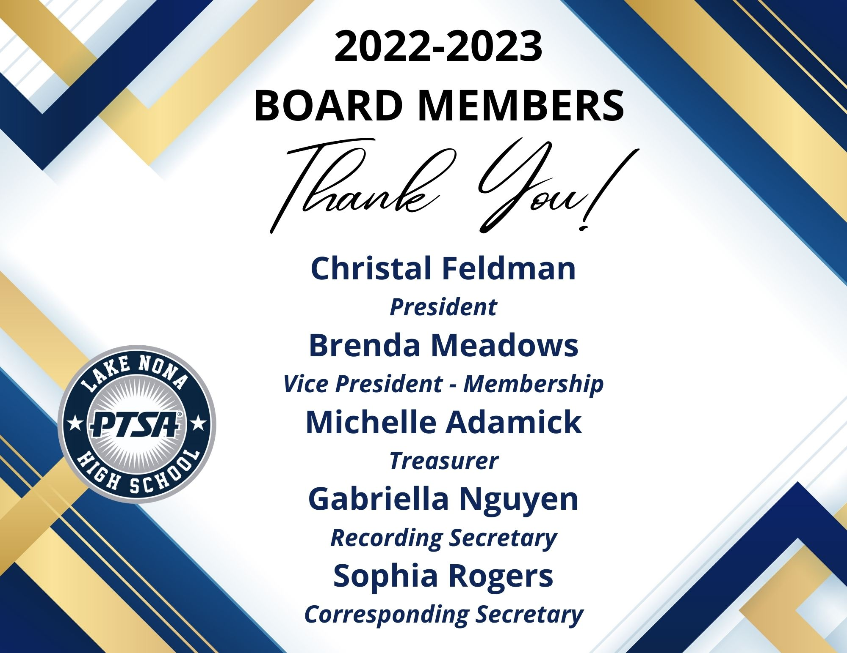

Slide 12
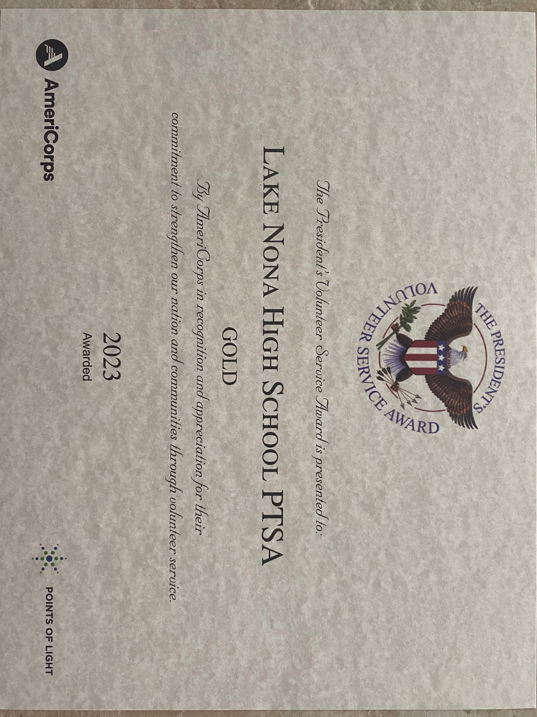
LNHS PTSA
Volunteers
(with over 25 hours each)
Gold Level
Group Award
Angie Garcia
Gabriella Nguyen
Gita Raghoonandan
Sophia Rogers
Suzanne Arnold
Tania Abreu
(The total hours for this
12-month period was 506.)

Slide 13

LNHS PTSA
Individual Awards
Gold Level
Christal Feldman
760 Hours
Michelle Adamick
505 Hours
Silver Level
Brenda Meadow
360 Hours

Slide 14
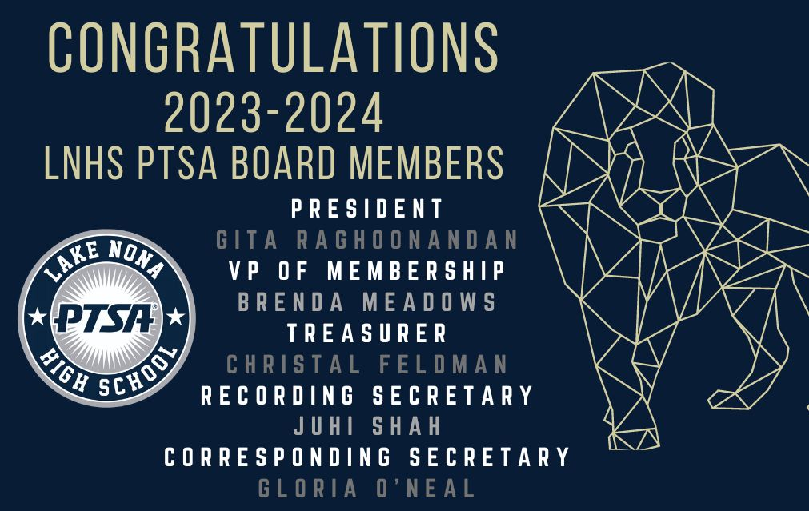

Slide 15







Thank You Community Partners!

Slide 16
LNHS PTSA is seeking committee co-chairs, program coordinators and committee members for the 2023-2024 school year...
Communications
Finance
Legacy Brick Sales
Learn with Lions Tutoring Program
Membership
Spirit Wear
Staff Appreciation
Senior Scholarship Program
Volunteers
Website
If you are interested in being a committee co-chair, program coordinator
or committee member, please email LNHSPTSA@gmail.com.
PTSA STAFF APPRECIATION

Slide 17
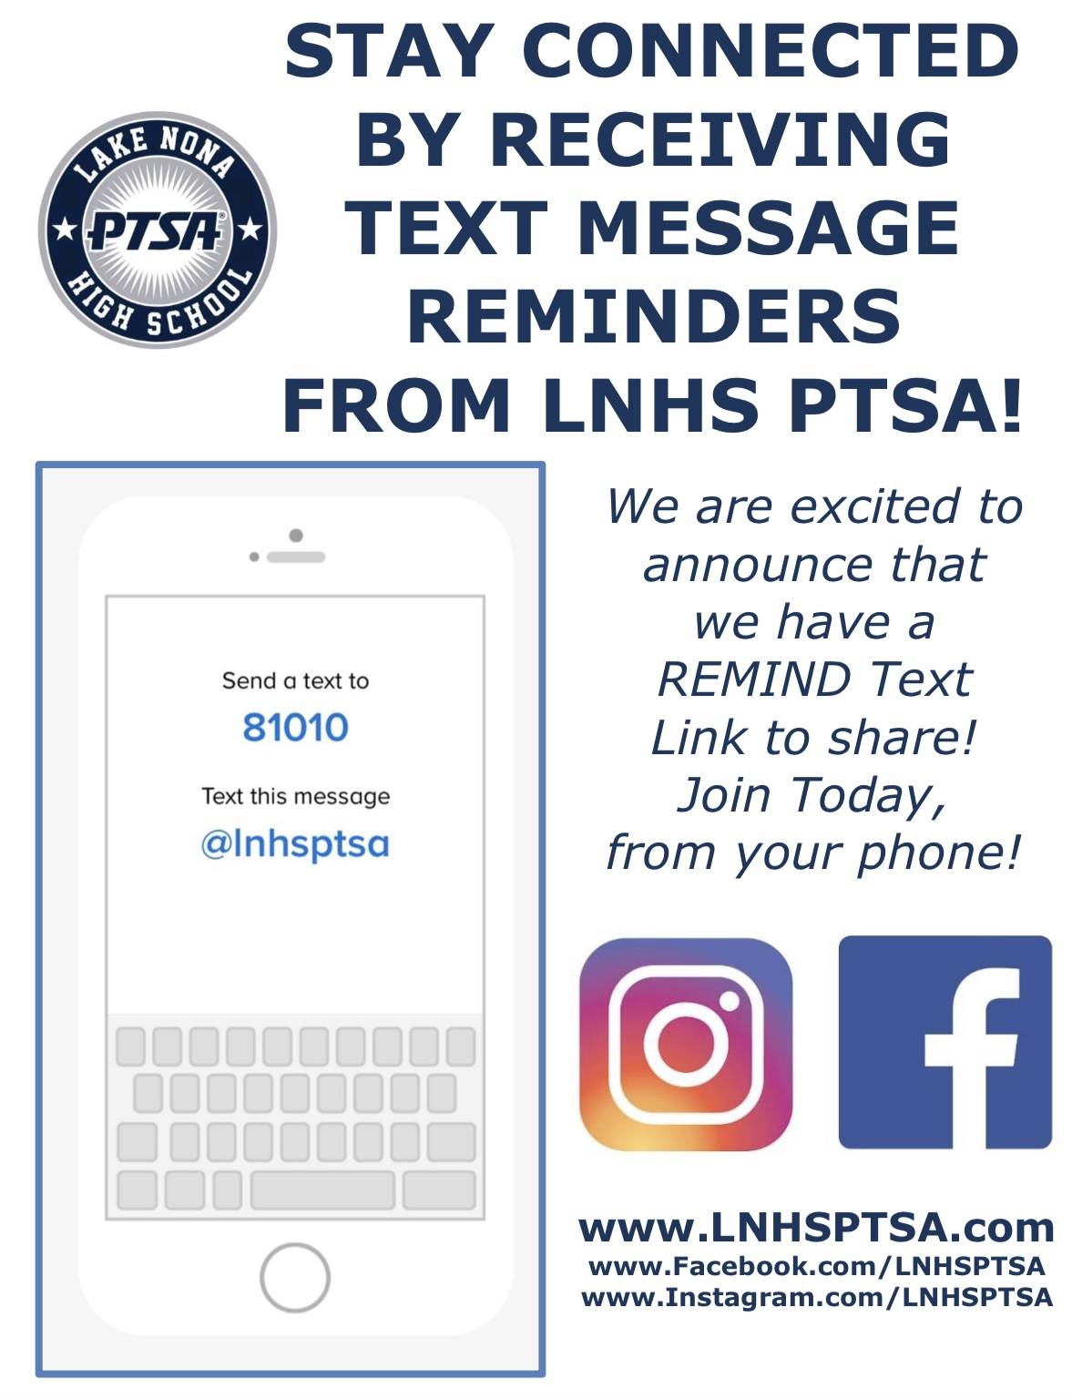
PTSA STAFF APPRECIATION

Slide 18


STAY CONNECTED
WITH LNHS PTSA
www.LNHSPTSA.com
www.Facebook.com/LNHSPTSA
Next General Meeting in August – Date TBD
Have a Safe and Relaxing Summer Break!

